Slide 1

Research @ Human Sciences Research Group

Slide 2
Three Broad Areas
Computational Human Sciences
Society and IT
Humanities and Social Sciences

Slide 3
Computational Human Sciences
Computer Science tools & methods to study problems in the Humanities and Social Sciences
Application of NLP, GIS, Data Analysis tools
Deploying AI and ML techniques
Digitising textual and material sources of research

Slide 4
Society and IT
Study impact of computers and information technology on society
How computers have changed the way we live and work
How information technology creates and mediates our world
What does digitisation do to humans
Ethical issues

Slide 5
Humanities and Social Sciences
Studying Problems from a purely HSS standpoint
Computer Science plays a minor, or negligible, role
One discipline: Sociology, Philosophy, Literature, History, Politics, Film Studies, Science-Technology Studies, etc

Slide 6
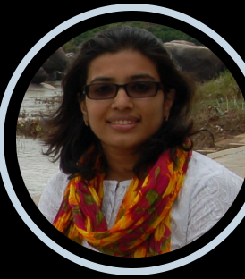
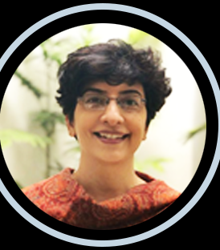
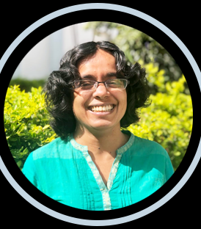
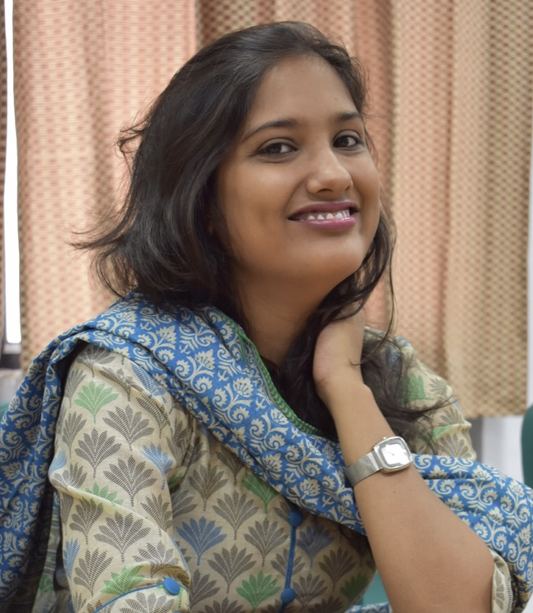
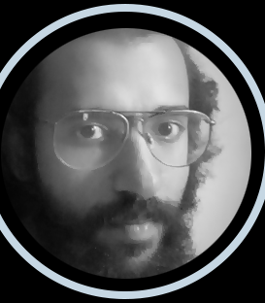
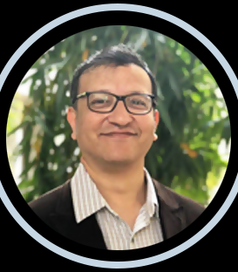
Faculty
Aakansha Natani
Aniket Alam
Ashwin Jayanti
Nazia Akhtar
Radhika Krishnan
Sushmita Banerji

Slide 7
Faculty Research Areas
Sushmita Banerji
Critical Theories of Film and Literature, Partition and Trauma Studies, Indian Cinema, and Contemporary US films
sushmita.banerji@iiit.ac.in
Nazia Akhtar
Literature and History of Hyderabad, Partition Studies, Women’s Writings, Comparative Literature
Nazia.Akhtar@iiit.ac.in

Slide 8
Faculty Research Areas
Ashwin Jayanti
Philosophy of Technology, History / Philosophy of Science, Moral Significance / Ontology of Technical Artefacts
ashwin@iiit.ac.in

Slide 9
Faculty Research Areas
Aakansha Natani
Internet and Democracy, E-Governance, Data Ownership and Privacy Debates, Online Civic Engagement and Political Culture, Digital Divide
aakansha.natani@iiit.ac.in

Slide 10
Faculty Research Areas
Radhika Krishnan
Science-Technology-Society Studies; Environment and Politics; Climate Change; Coal; Water and Rivers; Spatial Humanities
radhika.krishnan@iiit.ac.in
Aniket Alam
Himalayas and Mountain Societies; History and Politics of Modern India; Historical GIS; Social Network Analysis; Historical Big Data
aniket.alam@iiit.ac.in

Slide 11
Upcoming Research Areas
New Faculty:
Anirban Dasgupta
Economics, Development Studies
Isha Dubey
History, Politics
Saurabh Todariya
Philosophy

